Slide 1
CMPE279 Project Presentation
IoT Trash Can Monitoring System
Gaochao Wang
Ruizhe Song
Zixin Li

Slide 2
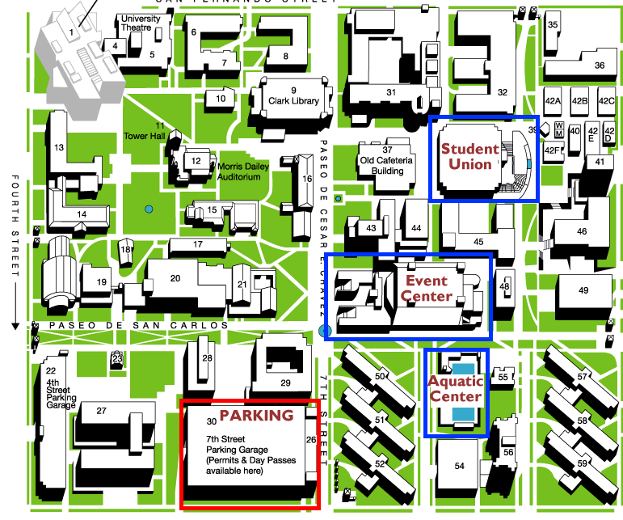
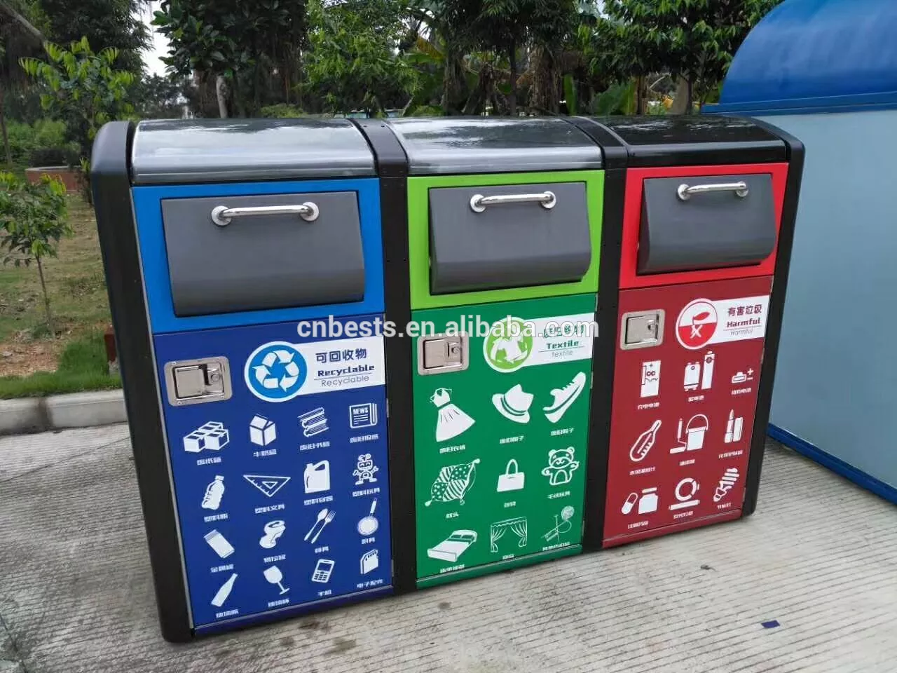
Introduction
It is a challlenging task to find out what/how many spots, how large the trash can is needed, and how often trash needs to be collected, to keep a clean environment in a cost effective way. Our IoT project is to provide a real time trash data monitoring, analysis and notification system for a environment like campus, park, shopping mall, etc.

Slide 3


Architecture
Database (MySQL)
• Store_user_data
• Register/Login_verification
• Init_device
• Receive_data
• Auto_report_data
• Receive_report_data
• Recieve_query_result
Front End /Browser
Server
Multiple Distributed
TrashCan
• Register Viewer
• Request_data
• query_history
• User_register/login
• Assign_DeviceID
• Request_data
• Receive_query_request
• Receive_data_to_store
• Return_query_result
Distributed Database (MongoDB) on Cloud(AWS)

Slide 4
Device
Circuit:
Swtich:
Sensors:
• GPS Sensor
• Weight Sensor
• Distance(Volume) Sensor

Slide 5
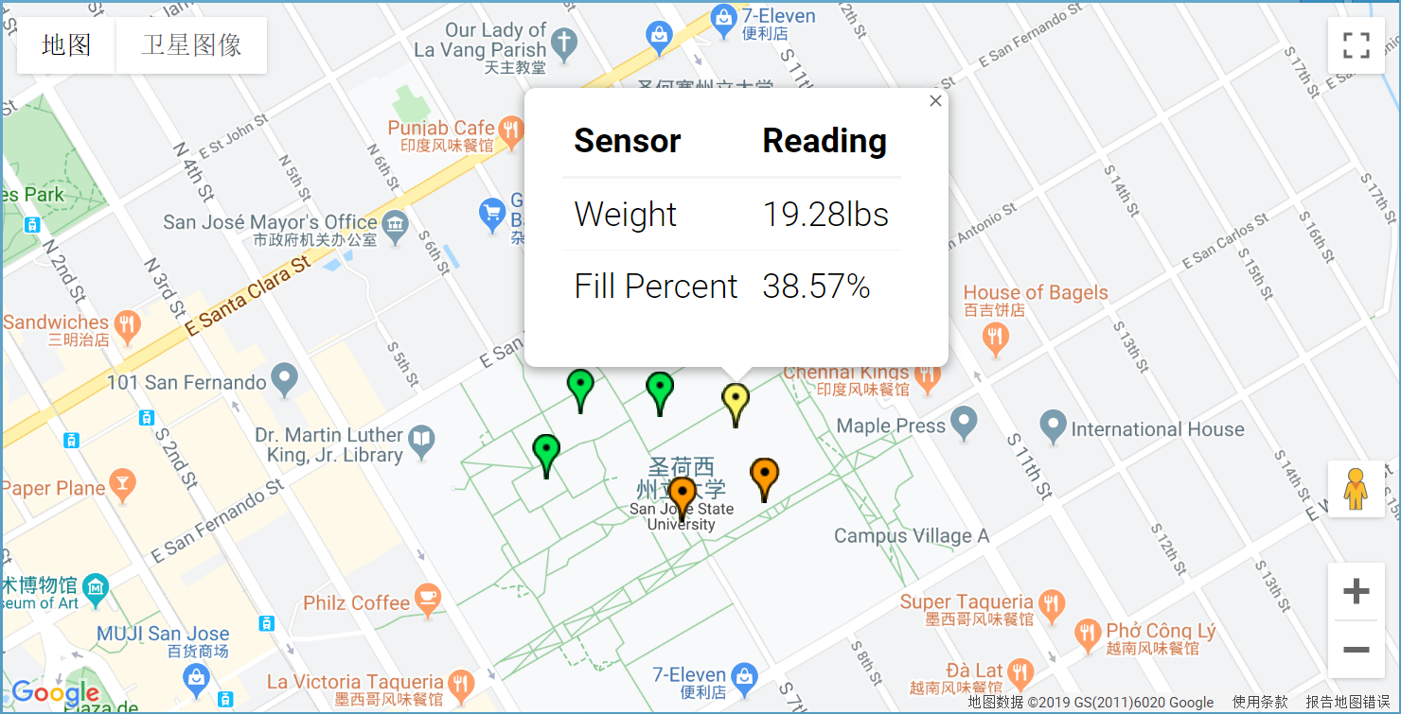
Use Case 1 - Monitoring
• Trash cans report data to server in every 5s.
• Server updates the real time data on user’s browser in a map view with colorful indicators(25%, 50%, 80%).
• Server sends the data to MongoDB for storage.

Slide 6
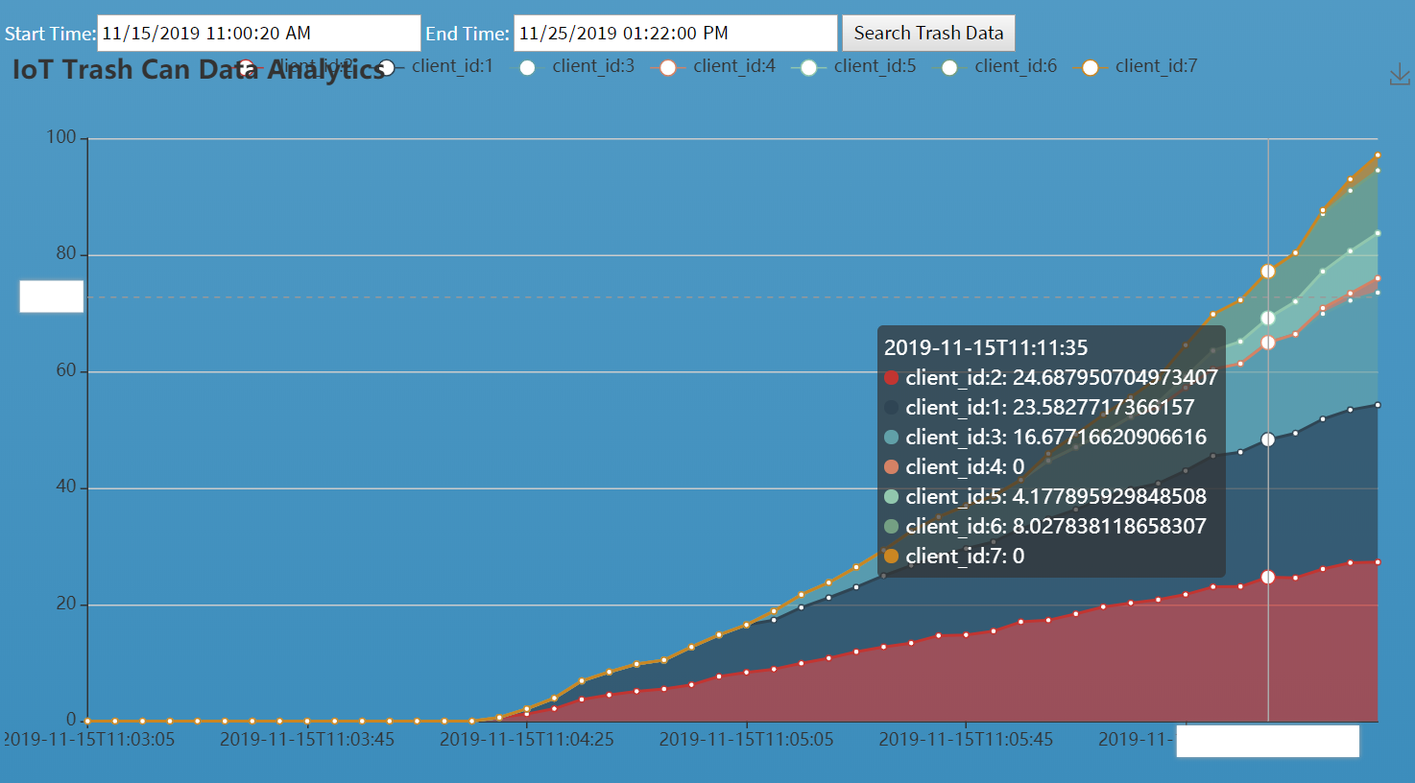
Use Case 2 - Analysis
• User is able to see history data about each trash can with reported timestamp.
• The most and least used trash can with its location can be found to improve trash can allocation plan .
• The total volume can be predicated and can be used to improve trash collection planning.

Slide 7
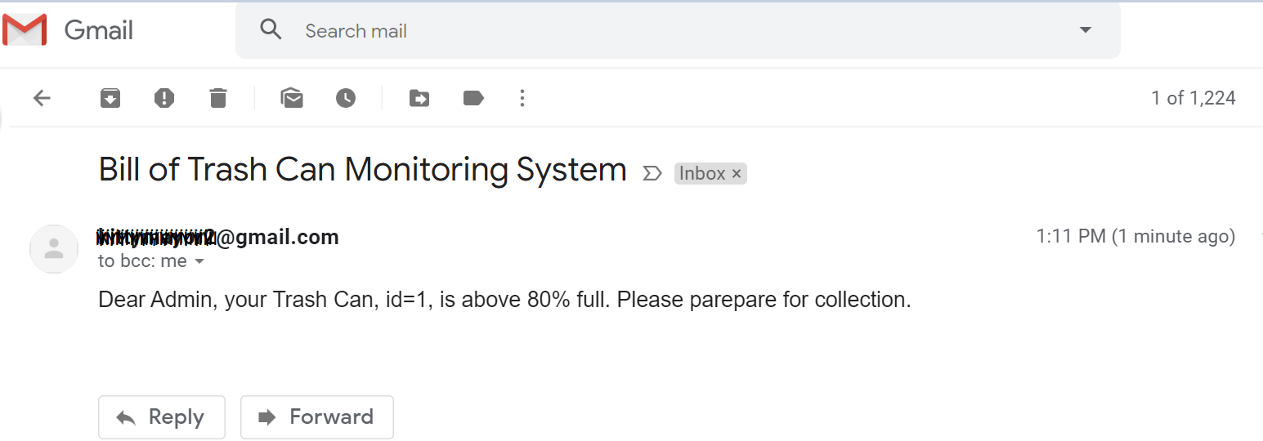
Use Case 3 - Notification
• When a Trash Can is 80% full, a notification email is sent to notify user.

Slide 8
DEMO

